Slide 1
Content
Introduction
Aim and Objectives
Literature Survey
Problem Definition
Proposed Solution Strategy
Project Plan
  6.1. H/W & S/W Requirement
    6.2. Design strategy solution
Implementation details
Results and Discussion
Conclusion
References

Slide 2
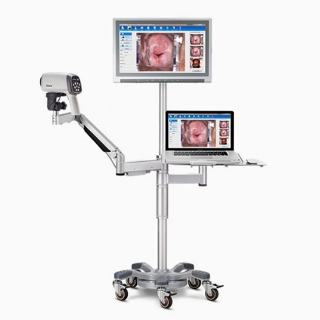
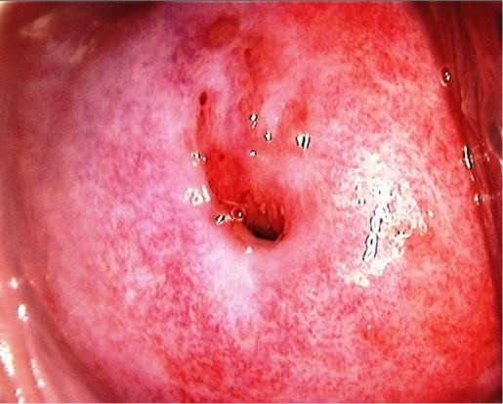
1. Introduction
Cervical cancer is a leading cause of cancer-related deaths among women, particularly in developing countries due to limited access to screening. In 2020, over 600,000 new cases and 340,000 deaths were reported globally. Early detection through screenings like colposcopy is essential for managing the disease and preventing its progression.
Colposcopy is a diagnostic procedure that provides a magnified view of the cervix, aiding in the detection of abnormalities. A colposcope, equipped with a light source and lenses, enhances visibility by creating high-resolution images, reducing the need for invasive procedures and enabling early treatment.
Figure 2. Colposcopic Image
Figure 1. colposcope

Slide 3
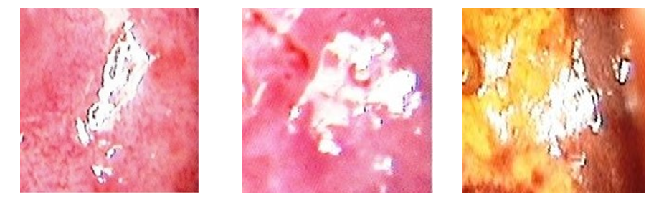
1. Introduction
Specular reflection (SR) appears as bright spots in colposcopic images, caused by light reflecting off moist cervical surfaces. SR obscures critical details, complicating image analysis and potentially leading to diagnostic errors. Addressing SR involves detecting and inpainting these regions to improve image clarity and diagnostic accuracy.
Traditional SR detection methods like thresholding are error-prone and struggle with lighting and texture variations. Manual approaches are slow and inconsistent. Our project uses U-Net for SR detection and GANs for inpainting, enabling fast, accurate segmentation and realistic texture reconstruction. This improves diagnostics and scales for clinical use.
Figure 3. Specular reflection (SR)

Slide 4
2. Aim and Objective
Aim
  The aim of this project is to develop an efficient technique to detect and in-paint specular reflections(SR) regions in colposcopic images.
Objectives
  To design and implement approach to accurately detect specular reflection regions in colposcopic images.
  To implement a machine learning-based approach for image inpainting to reconstruct the SR areas while preserving anatomical structure and texture.
  To evaluate the Performance and accuracy of the model.

Slide 5
3. Literature survey
Table 1.Literature survey
Sl.no | Title | Methodology | Research gap | Relevance
1. | Automatic Detection and Inpainting of Specular Reflections for Colposcopic Images [1] (2011) | Combined a reflection model with a technique to fill in missing image parts. | May not work well on all types of cervical images, especially those with varied lighting and colors. | Dichromatic Reflection Model
2. | Detection and Inpainting of Specular Reflection in Colposcopic Images.[2] (2019) | Used a method to detect and fill in bright areas in cervical images. | Ineffective for brighter regions with complex tissues. | Exemplar-based Method
3. | Specular Reflections Removal in Colposcopic Images Based on Neural Networks:Supervised training with no ground truth previous knowledge [3] (2021) | Applied neural networks to identify and remove bright spots without prior knowledge. | May require more training to retain underlying anatomical structure. | Proposed method may be used to estimate the unobserved anatomical cervix portion under the bright zones

Slide 6
3. Literature survey
Sl.no | Title | Methodology | Research gap | Relevance
4. | Elimination of Specular Reflection and Identification of ROI in Digital Colposcopy.[4] (2011) | Developed a technique to remove bright spots and focus on relevant image areas. | Proposedmethod may not effectively handle images with uneven lighting or those taken from different angles. | Laplace’s equation.
5. | Specular Reflection Analysis and Image Denoising in Cervix Images.[5] (2023) | Analyzed and reduced bright spots to enhance image quality. | Proposed technique uses a fixed brightness threshold to identify bright spots, which might not work well for all images due to differences in lighting and camera settings. | Threshold and gradient calculation.

Slide 7
4. Problem Definition
Specular Reflection Detection:
  Specular reflections caused by light reflection on moist tissue surfaces obscure important details in colposcopic images, making it difficult for clinicians toassess the cervix accurately.
Image Quality Degradation:
  Reflections lead to image distortion, reducing the overall quality and reliability of the images used for diagnosis and automated analysis.
Inpainting Challenge:
  Reconstructing the affected areas without distorting surrounding tissue structures is a complex task, requiring advanced inpainting algorithms that preserve anatomical structure.
  Limited Existing Machine Learning techniques:
  Current methods for dealing with specular reflections show limited effectiveness.

Slide 8
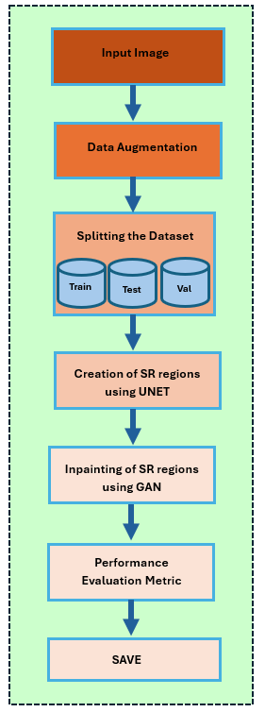
5. Proposed Solution Strategy
Implement image pre-processing techniques focused to accurately identify and locate specular reflections regions in colposcopic images.
Implement inpainting techniques, such as machine learning-based models to seamlessly reconstruct the areas affected by reflections, retaining the underlying structure of the cervix.
Evaluating model’s performance using performance metrics.
Figure 4. Solution strategy

Slide 9
6. Software Plan
6.1. Hardware and Software Requirement
Hardware Requirements:
Processor: Intel Core i5/i7 or equivalent (supporting deep learning tasks)
RAM: Minimum 8 GB (16 GB recommended)
GPU: NVIDIA GPU with CUDA support
Storage: 256 GB SSD or more (for datasets and model storage)
Software Requirements:
Operating System: Windows 10/11
Programming Language: Python 3.x
Libraries/Frameworks: TensorFlow, PyTorch, OpenCV, NumPy, Matplotlib
Tools: Anaconda, Visual Studio Code

Slide 10
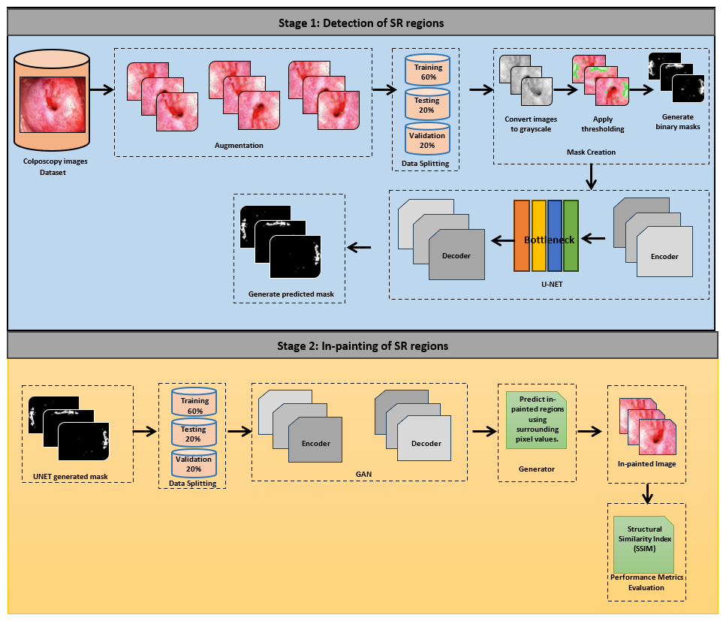
6.2 Design Strategy for the Solution
Flow Chart
Figure 7. Flow chart

Slide 11
6.4 Design Strategy for the Solution
Flowchart Summary
Data Collection and Preprocessing
  The dataset used in this research consists of colposcopy images obtained from ICMR. The dataset originally contains 926 images taken under various conditions such as original image, green filter, and iodine.
  To increase the dataset, we have employed data augmentation which ensures the robustness of the model. Various image augmentation is applied in the original dataset which is then expanded to a total of 2778 images, providing a more comprehensive dataset for training and evaluation.
  Thresholding and Mask Creation
  Applied thresholding to isolate bright SR regions, generating binary masks for training segmentation models.
Contours Detection
  Used OpenCV tools to delineate precise SR boundaries, ensuring accurate segmentation while preserving adjacent structures.

Slide 12
6.4 Design Strategy for the Solution
U-Net for Segmentation
  Leveraged U-Net’s encoder-decoder architecture for detailed segmentation, retaining spatial information with skip connections for accuracy and consistency.
GAN for Inpainting
  Utilized GAN’s generator to reconstruct SR-affected regions with lifelike textures, while the discriminator ensured realism. This step ensured seamless blending with surrounding tissues.
Performance Evaluation
  Measured outcomes using SSIM and pixel-wise accuracy, validating how closely reconstructed regions matched original data in texture and structure.

Slide 13
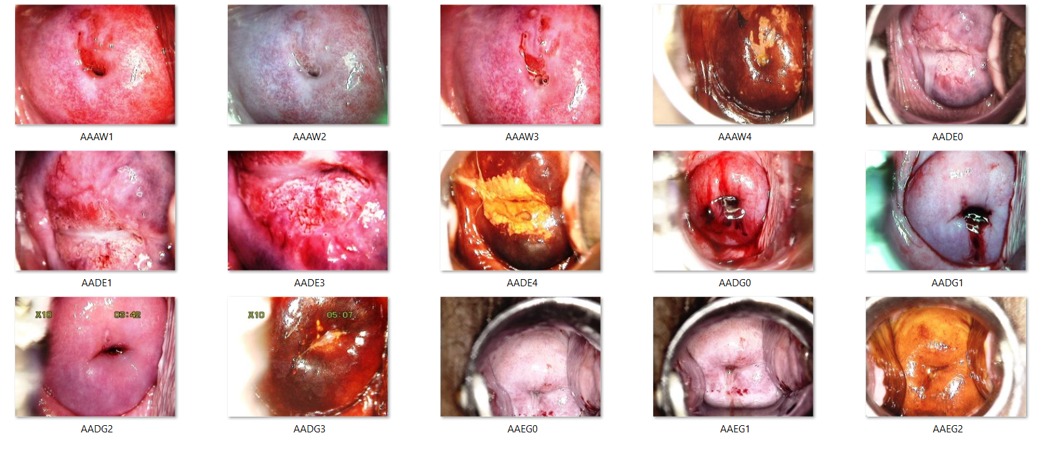
7. Implementation details
7.1. Experiment Environment
The experiments were conducted on a system with an Intel Core i7 processor, 16 GB RAM, and an NVIDIA GPU with CUDA for accelerated deep learning. The software stack included Python 3.13.3, TensorFlow, PyTorch, OpenCV, and NumPy, managed in Visual Studio Code for efficient workflow and debugging. This setup ensured smooth training and processing of large datasets.
7.2. Dataset information
The dataset used in this research consists of colposcopy images obtained from ICMR. The dataset originally contains 905 images taken under various conditions such as original image, green filter, and iodine.
Figure 8. Dataset

Slide 14
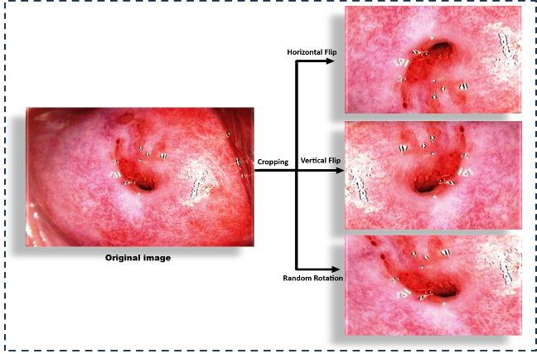
7. Implementation details
7.3. Data augmentation
To increase the dataset, we have employed data augmentation which ensures the robustness of the model. Various image augmentation is applied in the original dataset which is then expanded to a total of 2778 images, providing a more comprehensive dataset for training and evaluation.
Table 2. Data augmentation
Technique | Parameters
Cropping | 20% margin removed from all sides
Horizontal Flip | Flips the image along the vertical axis
Vertical Flip | Flips the image along the horizontal axis
Random Rotation | Angles between -30° to +30°
Figure 9. Data augmentation

Slide 15
7. Implementation details
7.4. Data splitting
After the image augmentation, the dataset increased to 2,778 colposcopic images which is then split into three subsets to train, validate, and test for the model learning, tuning and evaluation. Table 3 illustrates the number image subsets for the model.
Table 3. Data Splitting
Subset | Percentage | Number of Images
Training | 60% | 1,667
Validation | 20% | 556
Testing | 20% | 555

Slide 16
7. Implementation details
7.5. Specular Reflection Regions Detection
This project focuses on detecting specular reflection (SR) regions in colposcopic images. The process involves two key components:
Mask creation using traditional computer vision techniques (CV2):
The process starts by converting images to grayscale using OpenCV and applying a threshold of 230 to isolate SR regions. Contours of these bright areas are identified to create binary masks with SR regions filled (255) on a black background (0). Green contours (RGB 0, 255, 0) are overlaid on the original images for visual marking.
Table 4. mask creation using CV2
Parameter | Description | Value
Grayscale Conversion | Convert the image to grayscale | cv2.COLOR_BGR2GRAY
Threshold value | Value for isolating SR regions | 230
Threshold Max Value | Max value for binary threshold | 255
Contour Retrieval Mode | Mode for finding external contours | cv2.RETR_EXTERNAL
Contour Approximation | Method for approximating contour points | cv2.CHAIN_APPROX_SIMPLE
Mask Fill Value | Value to fill detected SR regions in mask | 255(white)
Contour Colour | Colour for SR region contours on the image | (0, 255, 0) (Green)
Contour Thickness | Thickness of the contour lines | 2 pixels
Supported File Extensions | Image format processed | .png, .jpg, .jpeg

Slide 17
7. Implementation details
7.5. Specular Reflection Regions Detection
Semantic segmentation using the U-Net model.
Convert colposcopic images to grayscale.
Apply thresholding (value: 230) to retain bright regions.
Generate a binary mask with SR regions marked as white(255) and others as black(0).
Extract contours from the binary mask to detect SR regions.
Use morphological operations to fill gaps and smooth boundaries.
Table 5. semantic segmentation using the U-Net model
Parameter | Technique
Thresholding | Applied strict intensity-based thresholding to isolate the brightest SR regions, focusing on high-intensity reflections.
Contour Detection | Extracted contours to map specular reflections accurately. Focused on larger reflective regions while ignoring minor artifacts.
Mask Creation | Binary masks were generated to represent specular regions, used for training the detection model. Masks were organized hierarchically for train, test, and validation datasets.
Green Overlay | Annotated detected regions with green outlines on the original images for easy visualization.

Slide 18
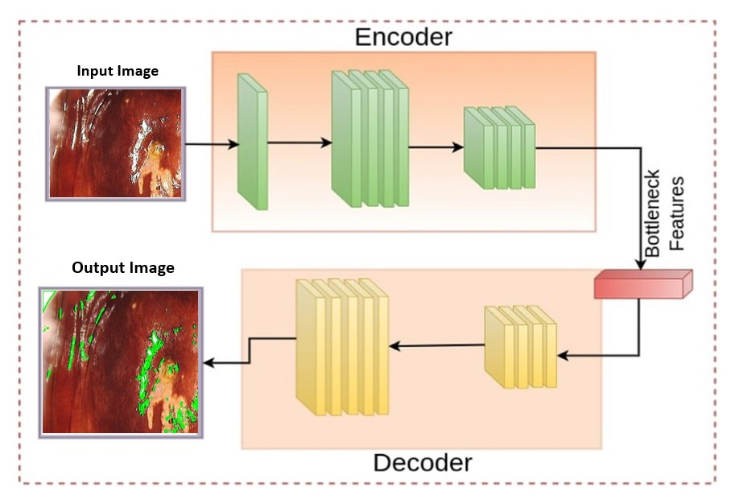
7. Implementation details
7.5. Generator Architecture:
U-Net
  Encoder: Extracts multi-scale contextual features from the input image.
  Bottleneck: Encodes high-level abstract features to represent the SR regions comprehensively.
  Decoder: Reconstructs the mask of image using up-sampling layers while integrating skip connections from the encoder.
Figure 10. U-Net Generator

Slide 19
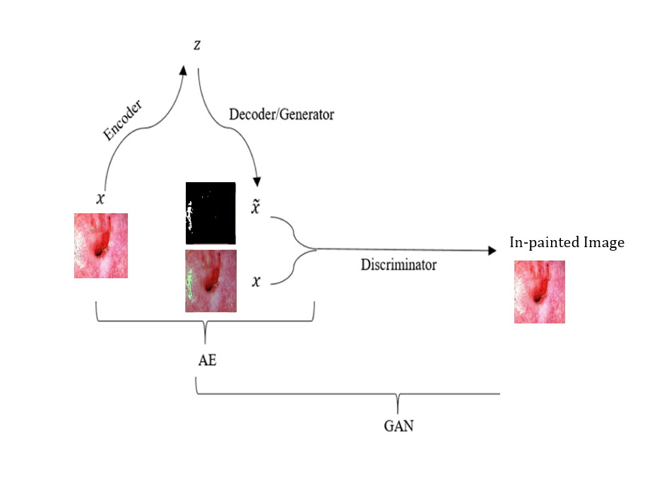
7. Implementation details
7.5. Generator Architecture:
GAN
  Encoder: Extracts and encodes high-level abstract and multi-scale contextual features from the input image and mask.
  Decoder: Reconstructs the in-painted image using up-sampling layers while integrating skip connections from the encoder.
Figure 11. GAN Generator Architecture

Slide 20
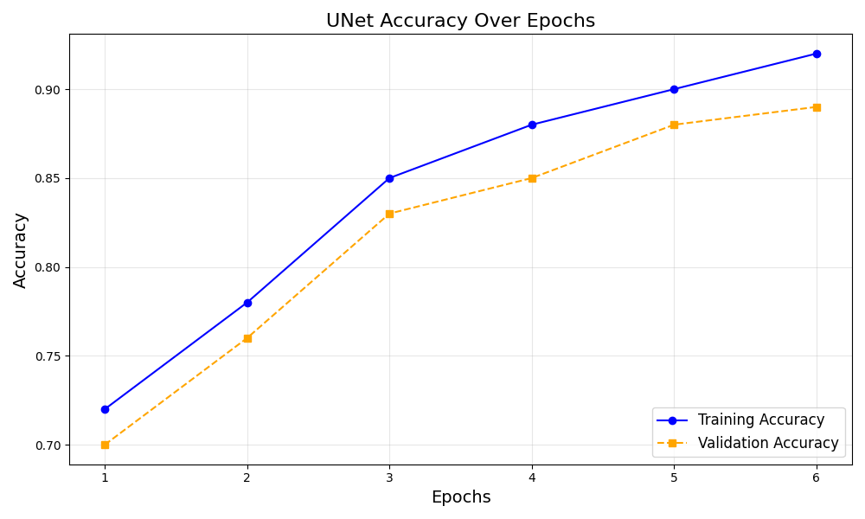
7. Implementation details
7.5. Performance evaluation:
U-Net accuracy:
The graph shows U-Net's training (blue)
and validation (orange-dashed) accuracy over epochs. Training accuracy improves
steadily, while validation accuracy
reflects generalization. The close
alignment of both lines indicates
successful training without
overfitting or underfitting, highlighting
the model's robustness.
Figure 12. U-Net accuracy

Slide 21
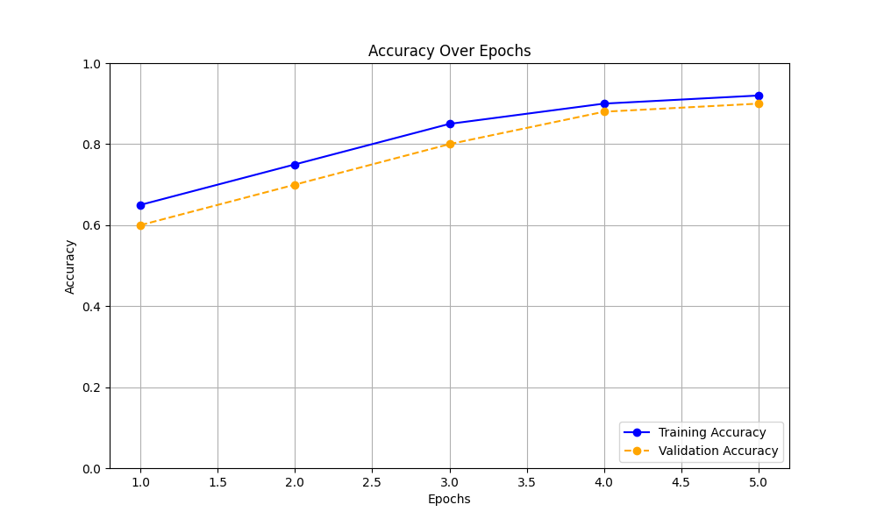
7. Implementation details
7.5. Performance evaluation:
GAN accuracy:
The graph illustrates the training and validation accuracy of the GAN model over multiple epochs. The training accuracy (blue line) shows the model's ability to correctly In-paint images in the training dataset, steadily improving as the model learns. The validation accuracy (orange-dashed line) reflects the model's performance.
Figure 13. GAN accuracy

Slide 22
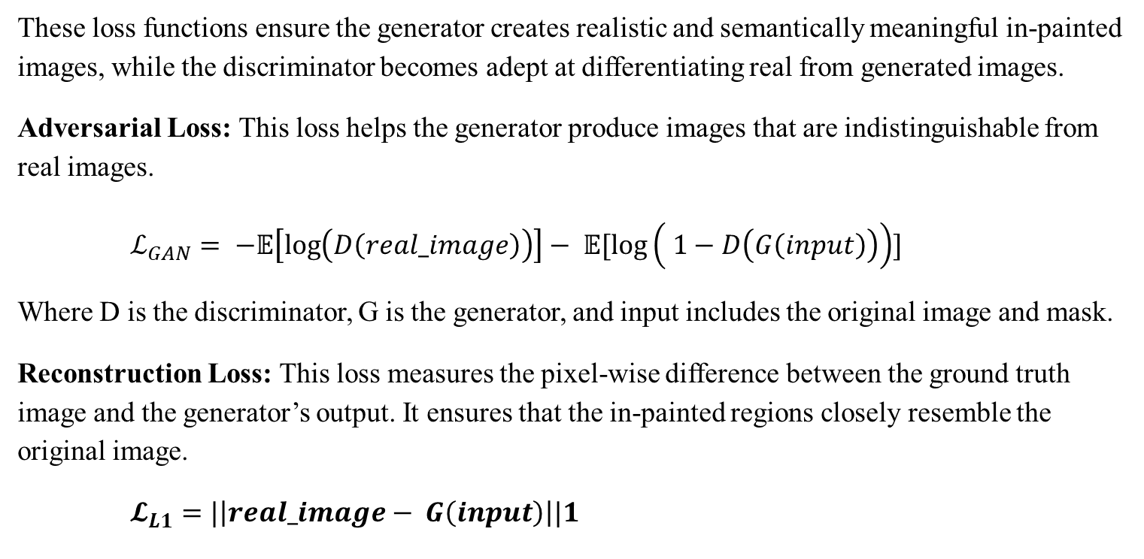
7. Implementation details
7.5. Performance evaluation:
GAN loss functions:
These loss functions ensure the generator creates realistic and semantically meaningful in-painted images, while the discriminator becomes adept at differentiating real from generated images.
Adversarial Loss: This loss helps the generator produce images that are indistinguishable from real images.
$ℒ_{GAN}= −𝔼\left[\log\left(D\left(real_image\right)\right)\right]− 𝔼[\log\left( 1−D\left(G\left(input\right)\right)\right)]$
Where D is the discriminator, G is the generator, and input includes the original image and mask.
Reconstruction Loss: This loss measures the pixel-wise difference between the ground truth image and the generator’s output. It ensures that the in-painted regions closely resemble the original image.
$𝓛_{L1}=|\left|real_image− G\left(input\right)\right||1$

Slide 23
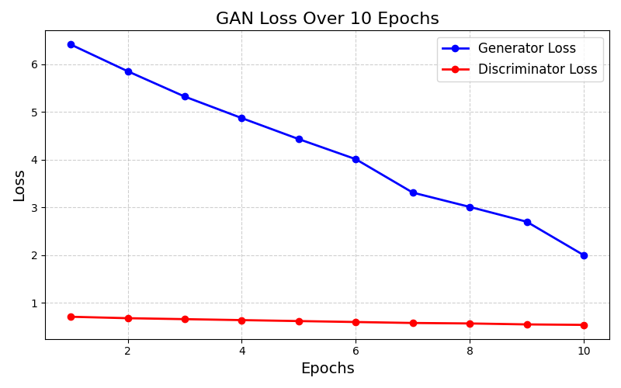

7. Implementation details
7.5. Performance evaluation:
GAN loss functions:
Total Loss: The total loss for the generator combines the adversarial and reconstruction losses:
$𝓛_{G}=$ $𝓛_{GAN}+ ⋋𝓛_{L1}$
Here, λ balances the importance of the two loss components
Figure 14. GAN loss over epoch

Slide 24
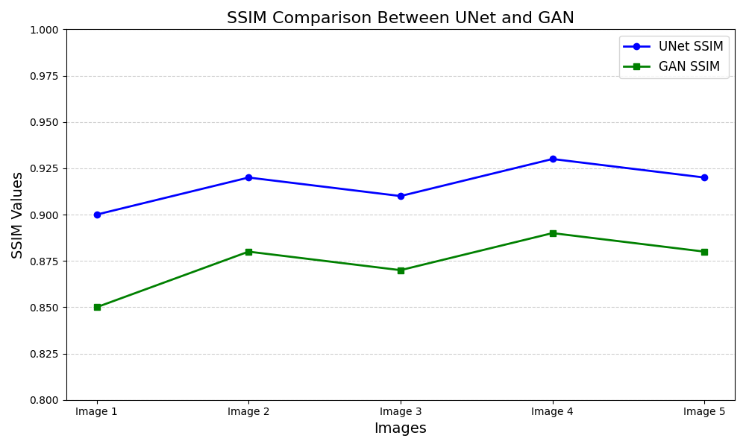
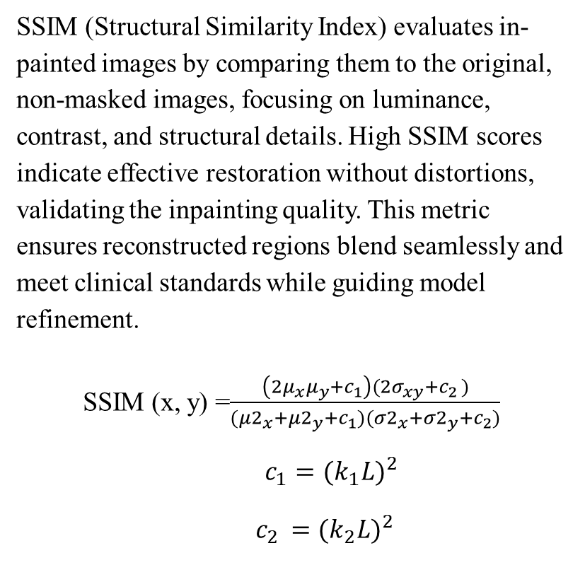
7. Implementation details
7.6. SSIM evaluation:
SSIM (Structural Similarity Index) evaluates in-painted images by comparing them to the original, non-masked images, focusing on luminance, contrast, and structural details. High SSIM scores indicate effective restoration without distortions, validating the inpainting quality. This metric ensures reconstructed regions blend seamlessly and meet clinical standards while guiding model refinement.
SSIM (x, y) =$\frac{\left({2μ}_{x}μ_{y}+c_{1}\right)({2σ}_{xy}+c_{2 })}{(μ2_{x}+μ2_{y}+c_{1})(σ2_{x}+σ2_{y}+c_{2})}$
$c_{1}=(k_{1}{L)}^{2}$
$c_{2 }=(k_{2}{L)}^{2}$
Figure 15. SSIM comparison

Slide 25
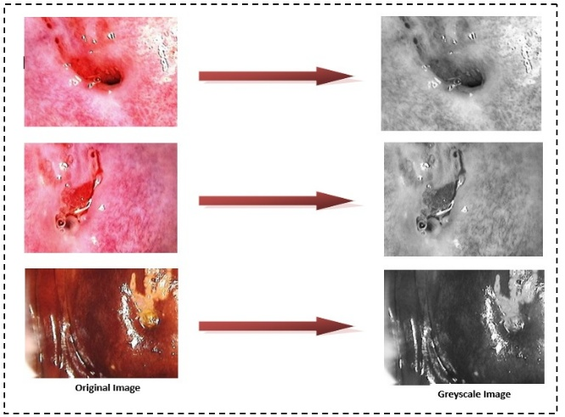
8. Results and discussion
Grayscale conversion simplifies preprocessing by reducing colposcopic images to intensity variations critical for detecting SR regions. This reduces complexity and eliminates irrelevant color data. U-Net uses these inputs to learn spatial features and predict SR regions accurately, ensuring consistent performance across datasets.
Figure 16. Grayscale conversion

Slide 26
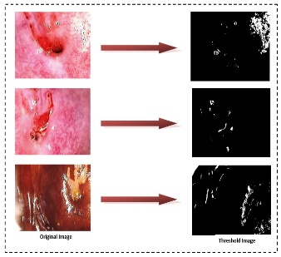
8. Results and discussion
Thresholding converts grayscale images into binary masks, marking pixel values above 230 as SR regions. These masks guide U-Net training, enabling it to learn spatial patterns and segment SR regions accurately, even in complex cases. Combining thresholding with U-Net ensures precise masks for inpainting while preserving tissue integrity for clinical use.
Figure 17. Mask creation

Slide 27
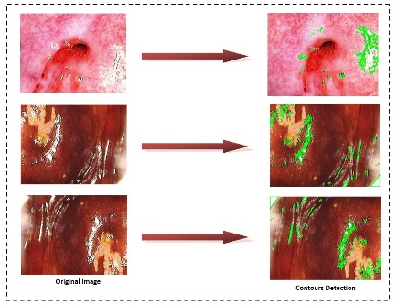
8. Results and discussion
Contours detection localizes SR regions in colposcopic images by refining binary masks from preprocessing steps like thresholding. U-Net enhances this process by learning spatial patterns and predicting precise boundaries using its encoder-decoder structure and skip connections. This automated approach eliminates manual errors and ensures accurate segmentation, supporting high-quality inpainting and clinical usability.
Figure 18. Contours detection

Slide 28
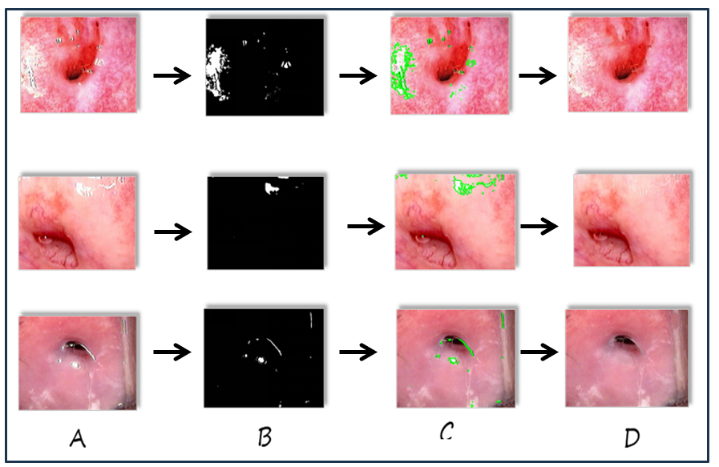
8. Results and discussion
In this project, U-Net is used for detecting SR regions in colposcopic images, ensuring seamless reconstruction and anatomical accuracy. Binary masks highlight SR areas, and the GAN’s encoder-decoder architecture captures features to in-paint missing regions. Skip connections ensure reconstructed areas blend naturally with unaffected parts. This approach delivers realistic results, outperforming traditional methods and supporting clinical diagnostics.
Figure 19. (A)Augmented image, (B)Mask, (C)Annotated image, (D)In-painted Image

Slide 29
9. Conclusion
The project focuses on solving the problem of bright spots (SR) in servical cancer images (colposcopic image) that affect their quality and accuracy.
It works by detecting and removing these spots from images.
Machine learning methods will be implemented to fill the affected areas and restore the image.
The solution is practical, using reliable algorithms and available tools.
It aims to improve image clarity and help achieve better results in analysis.
It uses various estimation matrix like SSIM to evaluate efficiency.

Slide 30
9. Conclusion
Difficulties Encountered During the Project
  Dataset Preparation: Managing and preprocessing datasets with multiple subfolders and formats required significant effort.
  Model Training: Ensuring compatibility between architectures (GAN and U-Net) involved multiple debugging sessions, especially in handling mismatched dimensions and loading pre-trained weights.
  Inpainting Quality: Achieving visually appealing inpainting results require fine-tuning hyperparameters and experimenting with different architectures.
  Resource Constraints: Training GANs is computationally intensive and require optimizing resources to avoid prolonged runtimes.

Slide 31
9. Conclusion
Future Scope of the Project
  Enhanced Models: Exploring state-of-the-art transformers or diffusion models for inpainting could yield better results.
  Real-Time Inpainting: Developing lightweight models for faster inpainting to enable real-time applications.
  Generalization: Extending the model to work across diverse datasets and use cases, such as medical imaging and video inpainting.
  Interactive Interface: Building an interactive GUI for user-friendly inpainting and visualization.
  Hybrid Approach: Combining GANs and diffusion models to improve both visual quality and computational efficiency.

Slide 32
9. Conclusion
Limitations of the Project
  Data Dependency: The quality of the inpainting heavily depends on the availability and diversity of the dataset.
  Processing Time: Despite optimization, the inpainting process remains computationally expensive for large datasets.
  Edge Cases: The model struggles with extreme variations, such as highly complex textures or irregular shapes.
  Model Scope: GANs are sensitive to mode collapse, which can reduce the diversity of generated outputs.

Slide 33
10. References
[1] El Meslouhi, Othmane, et al. "Automatic detection and inpainting of specular reflections for colposcopic images." Central European Journal of Computer Science 1 (2011): 341-354.
[2] Wang, Xiaoxia, et al. "Detection and inpainting of specular reflection in colposcopic images with exemplar-based method." 2019 IEEE 13th International Conference on Anti-counterfeiting, Security, and Identification (ASID). IEEE, 2019.
[3] Wang, X., Li, P., Lv, Y., Xue, H., Xu, T., Du, Y. and Liu, P., 2021. Integration of global and local features for specular reflection inpainting in colposcopic images. Journal of Healthcare Engineering, 2021(1), p.5401308.
[4] Jimenez-Martin, L., Pérez, D.A.V., Asteasuainzarra, A.M.S., Leonard, L. and Díaz-Romañach, M.L.B., 2021. Specular reflections removal in colposcopic images based on neural networks: Supervised training with no ground truth previous knowledge. arXiv preprint arXiv:2106.02221.
[5] Mukku, L. and Thomas, J., 2023, April. A Specular Reflection Removal Technique in Cervigrams. In 2023 IEEE International Conference on Contemporary Computing and Communications (InC4) (Vol. 1, pp. 1-5). IEEE.

